Slide 2
Software Defined Networks CYB 301 SDN Architecture
Egena Onu, PhD.
Computer Science Department,
Bingham University.

Slide 3
OpenFlow
OpenFlow is a set of protocols and an API, not a product per se or even a single feature of a product.
Put another way, the controller does nothing without an application program (possibly more than one) giving instructions on which flows go on which elements.
The OpenFlow protocols are divided in two parts:
Wired Protocol
Configuration and Management Protocol
Notes:
• A configuration and management protocol, of-config based on NETCONF (using Yang data models) to allocate physical switch ports to a particular controller, define high availability (active/standby) and behaviors on controller connection failure. Though OpenFlow can configure the basic operation of OpenFlow command/control it cannot (yet) boot or maintain (manage in an FCAPS context) an element.

Slide 4
Wired Protocol
Wired Protocol
OpenFlow wire protocol is used for:
Establishing a control session
Defining a message structure for exchanging flow modifications (flowmods)
Collecting statistics
Defining the fundamental structure of a switch (ports and tables).
It enables the ability to support multiple tables, stored action execution, and metadata passing—ultimately creating logical pipeline processing within a switch for handling flows.
Notes:
Talking about Wired Protocol is simply looking and the SDN switches and how the controller communicates with them.

Slide 5
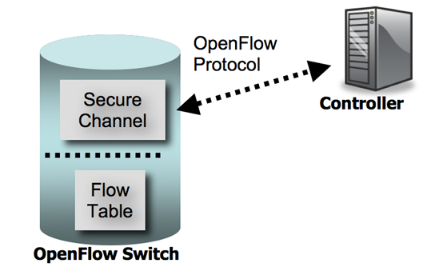
Wired Protocol
An OpenFlow switch consists of:
Flow Table
Secure Channel
Notes:
Flow Table performs packet lookup and forwarding.
Secure Channel connects to the external controller through which the controller controls the switch.

Slide 6
Wired Protocol
Flow Table
The flow table contains a set of:
Flow entries (header values to match packets against)
Activity counters
A set of zero or more actions to apply to matching packets.
All packets processed by the switch are compared against the flow table.
If a matching entry is found, any actions for that entry are performed on the packet (e.g., the action might be to forward a packet out a specified port).
If no match is found, the packet is forwarded to the controller over the secure channel.
The controller is responsible for determining how to handle packets without valid flow entries, and it manages the switch flow table by adding and removing flow entries.
Notes:
Flow entries may forward packets to one or more OpenFlow ports.
In general, these are physical ports, but the protocol does not preclude abstractions like port aggregations or VLAN traffic on a port appearing as an OpenFlow port.
OpenFlow ports have limited state such as “up”, “down” and whether spanning tree flood packets should be forwarded out the port.
Additional configuration of ports may handled by the OpenFlow configuration protocol. There are several OpenFlow virtual ports used to indicate, for example, flooding or the ingress port

Slide 7

Wired Protocol
Flow Table
A flow entry consists of:
Header fields to match against packets
Counter to update for matching packets
Actions (e.g., forwarding) to apply to matching packets
Notes:
Header Fields
Each entry contains a specific value, or ANY, which matches any value. If the switch supports subnet masks on the IP source and/or destination fields, these can more precisely specify matches.
Counter
Actions
Optional actions include:
Enqueue
Drop
Modify-field

Slide 8
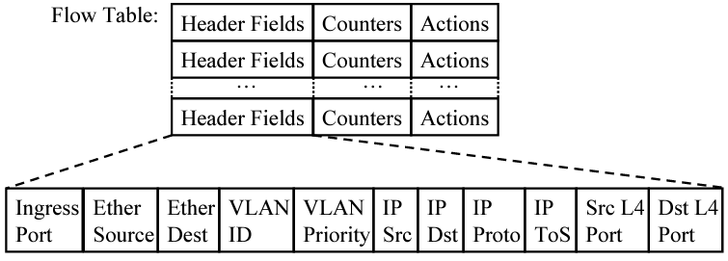
Wired Protocol

Slide 9
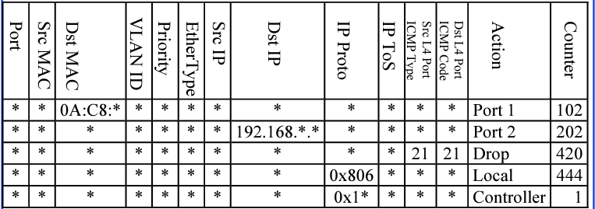
Wired Protocol
Flow table example

Slide 10
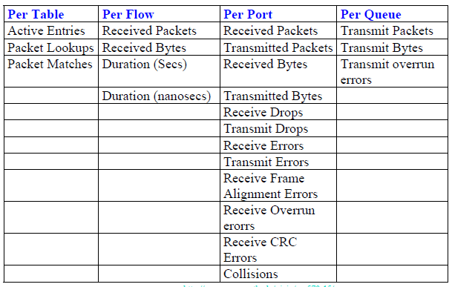
Wired Protocol
Counter Example

Slide 11
Wired Protocol
Actions
Forward to Physical Port i or to Virtual Port:
All: to all interfaces except incoming interface
Controller: encapsulate and send to controller
Local: send to its local networking stack
Table: Perform actions in the flow table
In_port: Send back to input port
Normal: Forward using traditional Ethernet
Flood: Send along minimum spanning tree except the incoming interface
Enqueue: To a particular queue in the port (e.g., for QoS purposes)
Drop
Modify Field: E.g., add/remove VLAN tags, ToS bits, Change TTL
Notes:
ToS: Type of Service

Slide 12
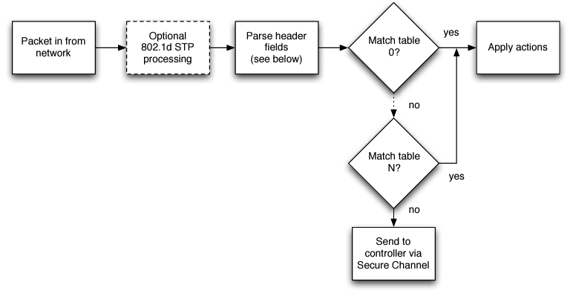
Wired Protocol
Matching
On receipt of a packet, an OpenFlow Switch performs the functions shown in this figure.

Slide 13
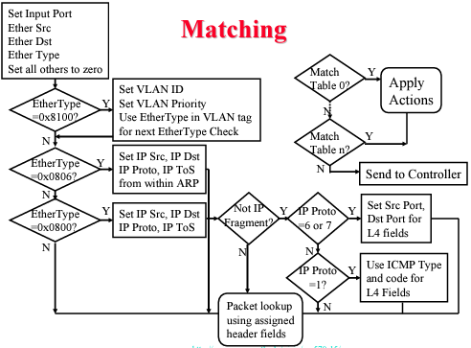
Wired Protocol
A detailed matching example

Slide 14
Wired Protocol
Secured Channel
The secure channel is the interface that connects each OpenFlow switch to a controller.
Through this interface, the controller configures and manages the switch, receives events from the switch, and send packets out the switch.

Slide 15
Wired Protocol
OpenFlow Protocol Communications
The OpenFlow protocol supports three message types, each with multiple sub-types:
Controller-to-switch
Asynchronous
Symmetric,.

Slide 16
Wired Protocol
Controller-to-Switch
Controller-to-switch messages are initiated by the controller and used to directly manage or inspect the state of the switch.
Controller-to-switch messages may or may not require a response from the switch.
These messages include:
Features: Upon Transport Layer Security (TLS) session establishment, the controller sends a features request message to the switch. The switch must reply with a features reply that specifies the capabilities supported by the switch.
Configuration: The controller is able to set and query configuration parameters in the switch. The switch only responds to a query from the controller.

Slide 17
Wired Protocol
Controller-to-Switch Communications
Modify-State: Modify-State messages are sent by the controller to manage state on the switches. Their primary purpose is to add/delete and modify flows in the flow tables and to set switch port properties.
Read-State: Read-State messages are used by the controller to collect statistics from the switch's flow-tables, ports and the individual flow entries.
Send-Packet: These are used by the controller to send packets out of a specified port on the switch.
Barrier: Barrier request/reply messages are used by the controller to ensure message dependencies have been met or to receive notifications for completed operations.

Slide 18
Wired Protocol
Asynchronous
Asynchronous messages are initiated by the switch and used to update the controller of network events and changes to the switch state.
Asynchronous messages are sent without the controller soliciting them from a switch.
Switches send asynchronous messages to the controller to denote:
A packet arrival.
Switch state change
Error.
The four main asynchronous message types: packet-in, flow-removed, port-status and error.
Notes:
Packet-in: For all packets that do not have a matching flow entry, a packet-in event is sent to the controller (or if a packet matches an entry with a “send to controller” action). If the switch has sufficient memory to buffer packets that are sent to the controller, the packet-in events contain some fraction of the packet header (by default 128 bytes) and a buffer ID to be used by the controller when it is ready for the switch to forward the packet. Switches that do not support internal buffering (or have run out of internal buffering) must send the full packet to the controller as part of the event.
Flow-Removed: When a flow entry is added to the switch by a flow modify message, an idle timeout value indicates when the entry should be removed due to a lack of activity, as well as a hard timeout value that indicates when the entry should be removed, regardless of activity. The flow modify message also specifies whether the switch should send a flow removed message to the controller when the flow expires. Flow modify messages which delete flows may also cause flow removed messages.
Port-status: The switch is expected to send port-status messages to the controller as port configuration state changes. These events include change in port status (for example, if it was brought down directly by a user) or a change in port status as specified by 802.1D (see Section 4.5 for a description of 802.1D support requirements).
Error: The switch is able to notify the controller of problems using error messages

Slide 19
Wired Protocol
Symmetric
Symmetric messages are initiated by either the switch or the controller and sent without solicitation
Symmetric messages are sent without solicitation, in either direction.
These messages include:
Hello
Echo
Vendor
Notes:
Hello: Hello messages are exchanged between the switch and controller upon connection startup.
Echo: Echo request/reply messages can be sent from either the switch or the controller, and must return an echo reply. They can be used to indicate the latency, bandwidth, and/or liveness of a controller-switch connection.
Vendor: Vendor messages provide a standard way for OpenFlow switches to offer additional functionality within the OpenFlow message type space. This is a staging area for features meant for future OpenFlow revisions

Slide 20
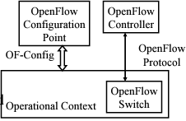
Configuration and Management Protocol
The configuration and management protocol consists of OpenFlow Control Point and the OF-Config.
OpenFlow Control Point: Entity that configures OpenFlow switches
OF-Config: Protocol used for configuration and management of OpenFlow Switches.
OF-Config allows for the assignment of OF controllers so that switches can initiate connections to them:
IP address of controller
Port number at the controller
Transport protocol: TLS or TCP
Configuration of queues (min/max rates) and ports
Enable/disable receive/forward speed, media on ports

Slide 21
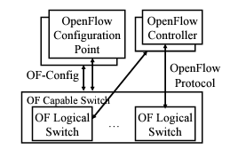
Configuration and Management Protocol
Concepts of OF-Config
OF Capable Switch: Physical OF switch. Can contain one or more OF logical switches.
OpenFlow Configuration Point: configuration service
OF Controller: Controls logical switch via OF protocol
Operational Context: OF logical switch
OF Queue: Queues of packets waiting for forwarding
OF Port: forwarding interface. May be physical or logical.
OF Resource: ports, queues, certificates, flow tables and other resources of OF capable switches assigned to a logical switch
Datapath ID: 64-ID of the switch. Lower 48-bit = Switch MAC address, Upper 16-bit assigned by the operator

Slide 22
Questions!!!

